Slide 1
CPE 133: Lecture 19
FSM Review
Verilog Behavioral FSM Models
Experiment #10

Slide 2
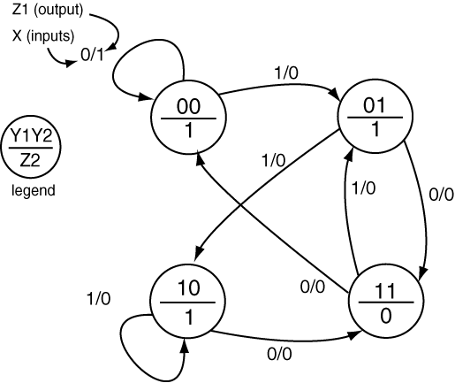
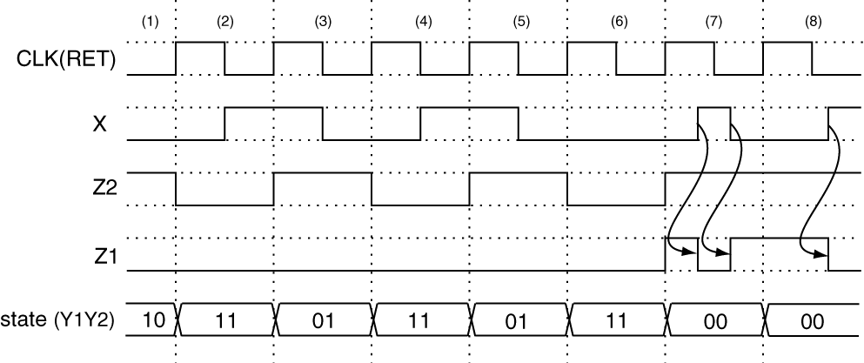
Timing Diagram
Moore
Mealy

Slide 3
FSM Modeling with Verilog
Generic FSM Model
Verilog FSM Model

Slide 4
The Verilog FSM Template
Many ways to do model FSM in Verilog
Pick one; stick with it
FSM Modeling in Verilog
Not engineering, total grunt work
Only looks intimidating for a few minutes
Know where to find copy of template
Don’t do start Verilog FSM model from scratch

Slide 5
Verilog FSM Template: Interface
Black Box Diagram
module fsm_template(reset_n, x_in, clk, mealy, moore);
input reset_n,
input x_in,
input clk;
output reg mealy;
output reg moore;
Verilog interface code

Slide 6
Verilog FSM Template: State Specification
Provide NS & PS declarations
As reg (assigned in states)
Provide bit values for each state
Each state must have unique values
//- next state & present state variables
reg [1:0] NS, PS;
//- bit-level state representations
parameter [1:0] st_A=2'b00, st_B=2'b01, st_C=2'b11;
State specification

Slide 7
Verilog FSM Template: Sequential Block
Assigns PS
Memory associated with PS
Sequential module, non-blocking assignment used
Sequential statements, so asynchronous signal has precedence
//- model the state registers
always @ (negedge reset_n, posedge clk)
if (reset_n == 0)
PS <= st_A;
else
PS <= NS;
State register model

Slide 8
always @ (x_in,PS)
begin
mealy = 0; moore = 0; //- assign all outputs
case(PS)
st_A: //--------------------------------
begin
moore = 1;
if (x_in == 1)
begin
mealy = 0; NS = st_A;
end
else
begin
mealy = 1; NS = st_B;
end
end
st_B: //--------------------------------
begin
moore = 0; mealy = 1; NS = st_C;
end
st_C: //--------------------------------
begin
moore = 1;
if (x_in == 1)
begin
mealy = 1; NS = st_B;
end
else
begin
mealy = 0; NS = st_A;
end
end
default: NS = st_A; //- catchall
endcase
end
State Diagram

Slide 9
Exp #10: 3-Bit Up/Down Counter
Counter with multiple control inputs
Implement FSM with Verilog behavioral model
Asynchronous signals go in sequential process
Synchronous signals go in combinatorial process
Output display:
Use seven-seg decoder or univ_sseg.v
Choose any buttons/switches you want
Top-level BBD Exp #10

Slide 10
Experiment #10 Tips
Big FSM, lots of repetition
Be clever with combinatorial procedural block
Code in procedural blocks is sequential
If HOLD = 1 then don’t change state
If the previous statement does not test true, you know HOLD must be ‘0’; you don’t need to check that condition in later if clauses
Nested if’s with simple conditions are better than non-nested if’s with complex conditions

Slide 11
Design Problem #5 (from previous)
Design a circuit that blinks an LED with a 50% duty cycle if a button is pressed; otherwise the LED blinks with a 25% duty cycle. It’s OK for one duty cycle to be off in some cases where the button changes state.
Include a black box diagram (BBD)
Include a state diagram

